Slide 1
TERM 3
MATHEMATICS
GRADE 2 YEAR 2

Slide 2
LESSON PLAN CONTENT
WEEK 1-2 | Numbers, Operations and relationships Identify and read numbers 1-40 Counting with whole numbers Identify, recognize and read numbers 0-18 Count backwards and forward
WEEK 3 | Numbers, Operations and relationships Order numbers from biggest to smallest, and from smallest to biggest. Smaller than, greater than, more than, less than, and equal to. Position objects in line from first to tenth.
WEEK 4 | Patterns, functions, and algebra Sequences

Slide 3
LESSON PLAN CONTENT CONT…
WEEK 5 | Measurement Days of the week, concept of today and tomorrow and birthday charts.
WEEK 6 | Space and shape 3D shapes
WEEK 7 | Space and Shape Features of shapes
WEEK 8 | Numbers, Operations and Relationships Addition and Subtraction
WEEK 9 | Numbers, Operations and Relationships South African coins and bank notes

Slide 4

Week 1-2

Slide 5
Lesson objectives
Identify and recognize numbers from 1-40.
Count everyday objects reliable.
Identify numbers on the number chart or on the chalkboard.
Read number symbols from 0-18.

Slide 6
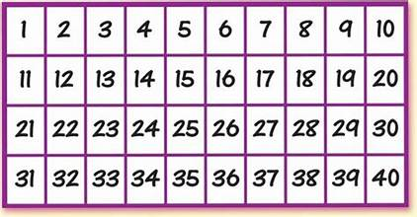
Count 1-40

Slide 7
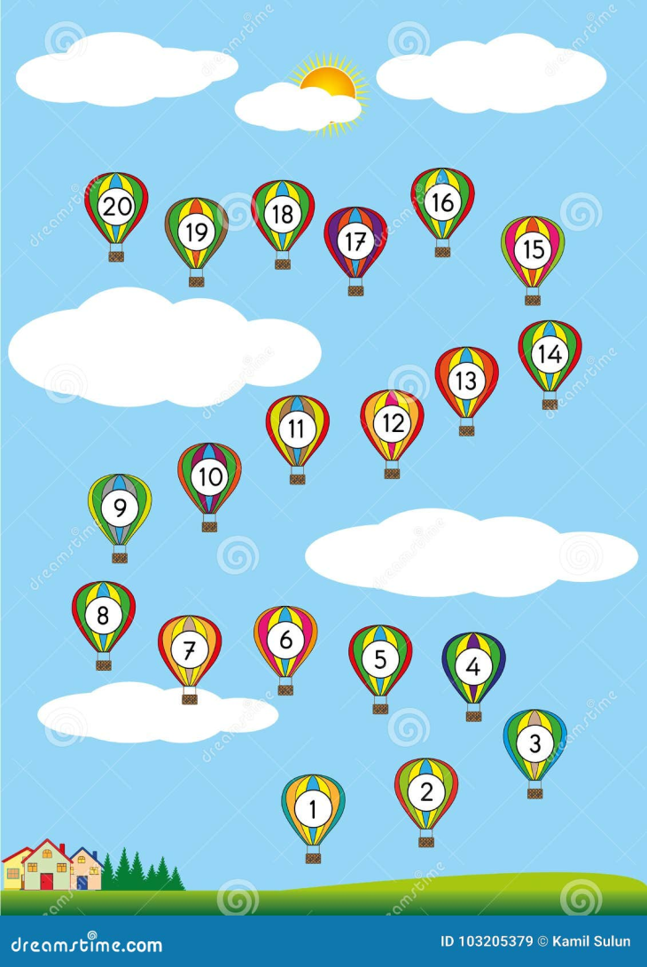
Counting backwards and forward

Slide 8
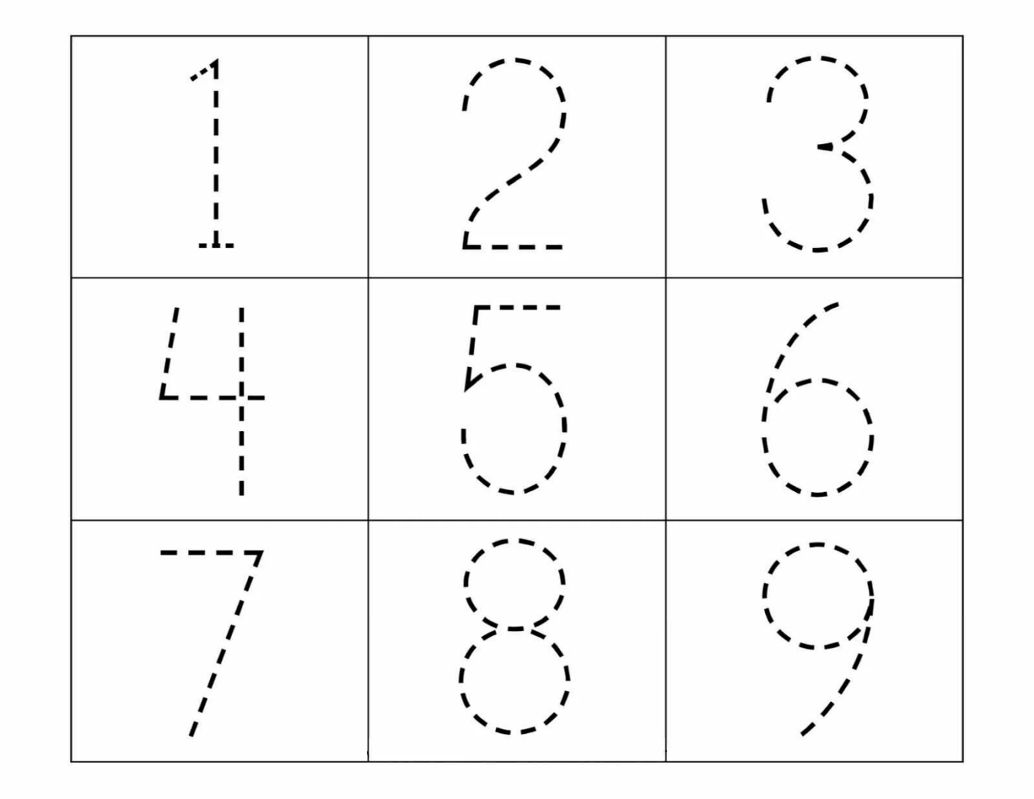
Group 1
Trace the following numbers

Slide 9
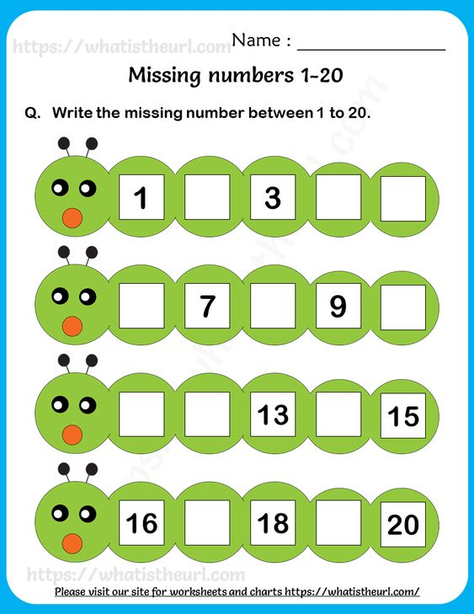
Group 2

Slide 10
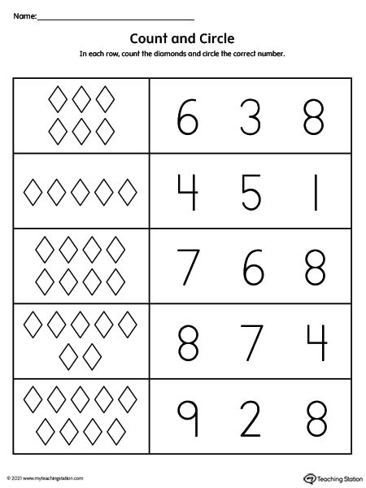
Group 3

Slide 11
Week 3
Describe, compare and order numbers.

Slide 12
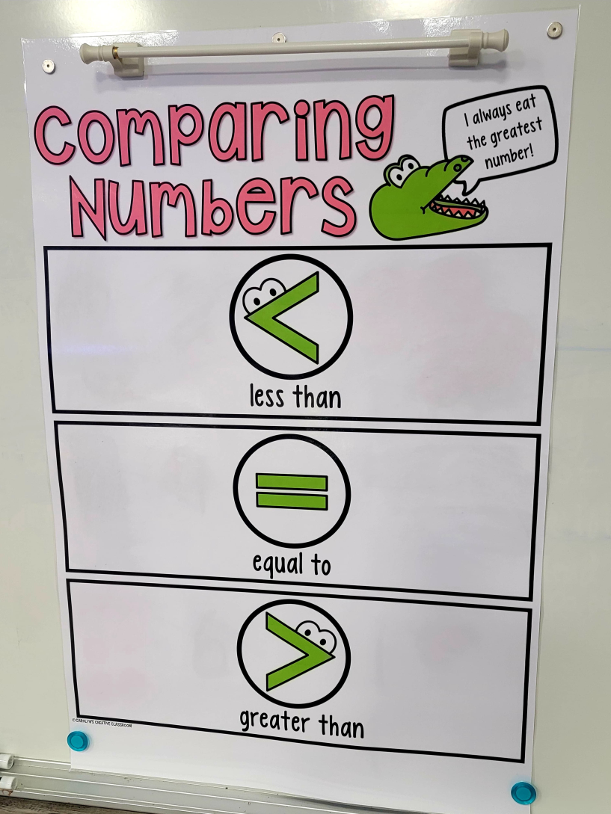

Slide 13
Lesson objectives
Order numbers from the smallest to the biggest and also from the smallest to the biggest.
Write numbers from 1 up to 40.
Compare numbers from 1 up to 40 using big, small, more, less and equal to.
Position different objects in a line from first to tenth.

Slide 14
Ordering numbers

Slide 15
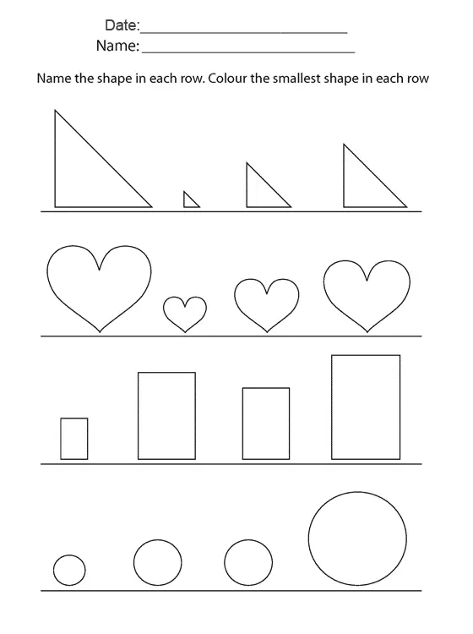
Group 1

Slide 16
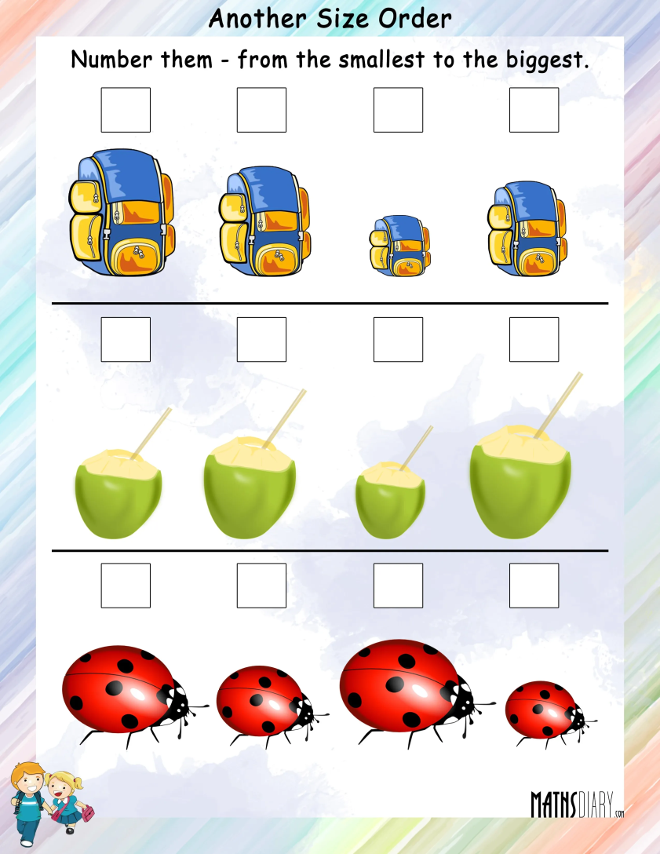
Group 2

Slide 17
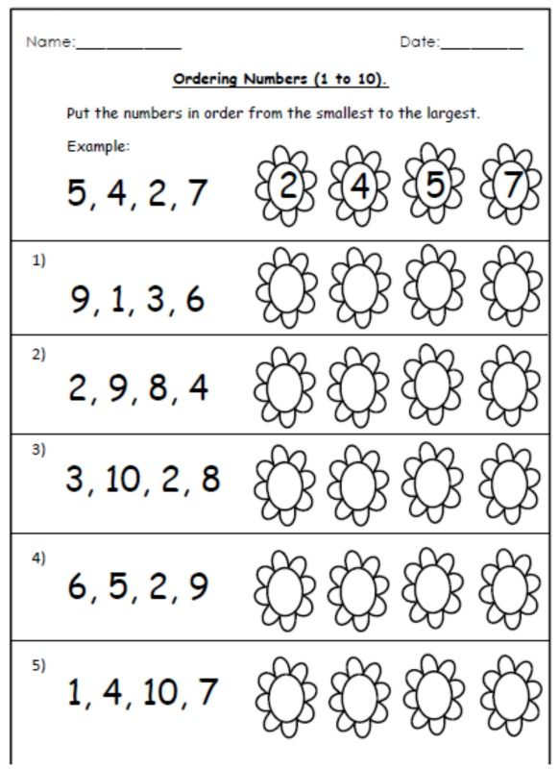
Group 3

Slide 18

Week 4
Sequences

Slide 19
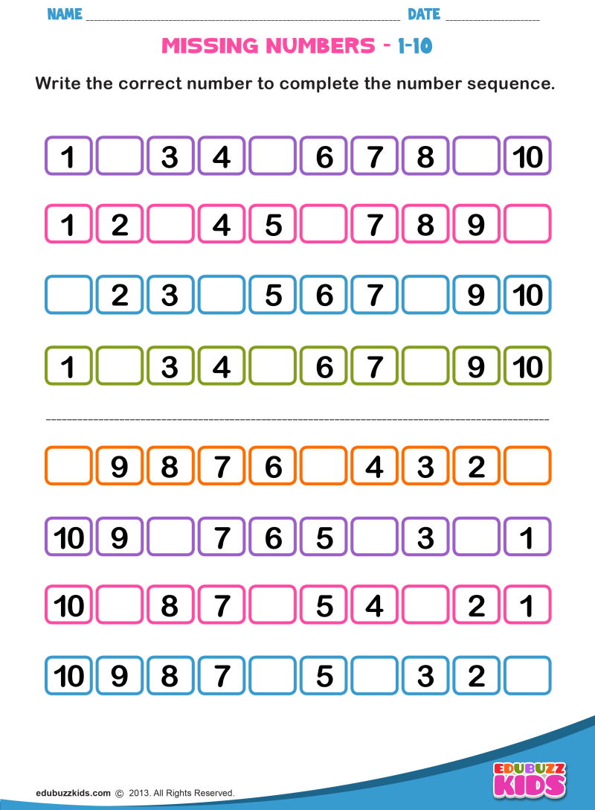
Lets complete the sequence!

Slide 20
Lesson objectives
Count forward in 1’s.
Count forward in 5’s.
Count forward in 10’s.
Arrange the sequence.

Slide 21
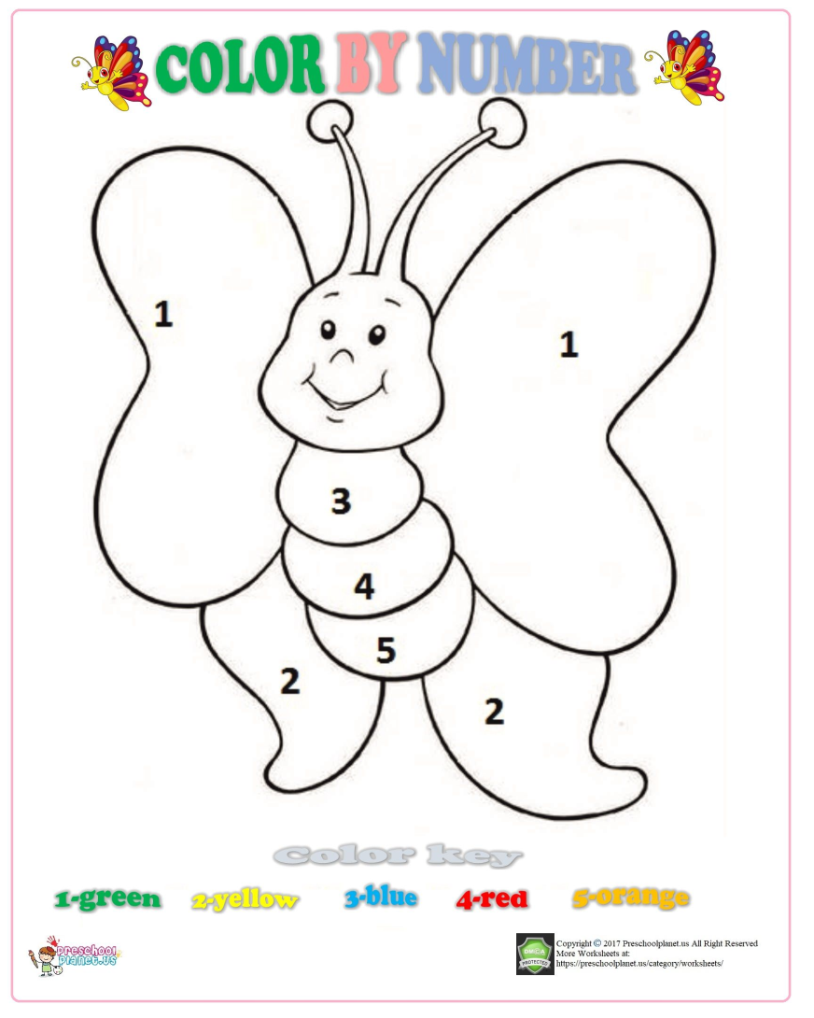
Group 1

Slide 22
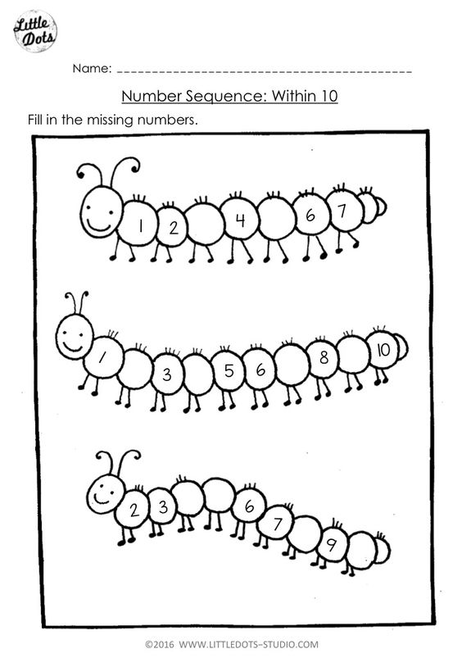
Group 2

Slide 23
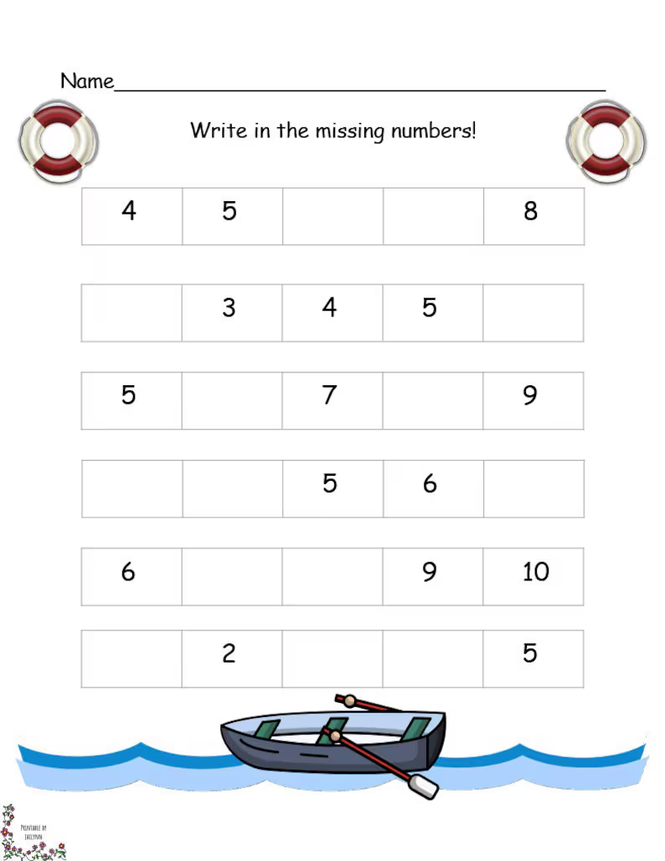
Group 3

Slide 24
Week 5
Days of the week, concept of today and tomorrow and birthday charts.

Slide 25
Lesson objectives
Identify the days of the week in order.
Understand the concept of today and tomorrow.
State their birthdays.

Slide 26

Group 1
Sing along

Slide 27
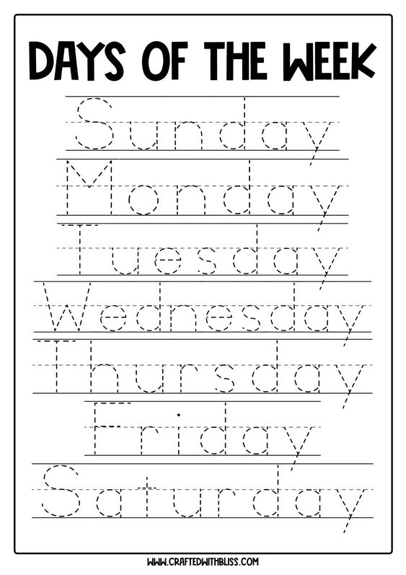
Group 2
Trace the days of the week

Slide 28
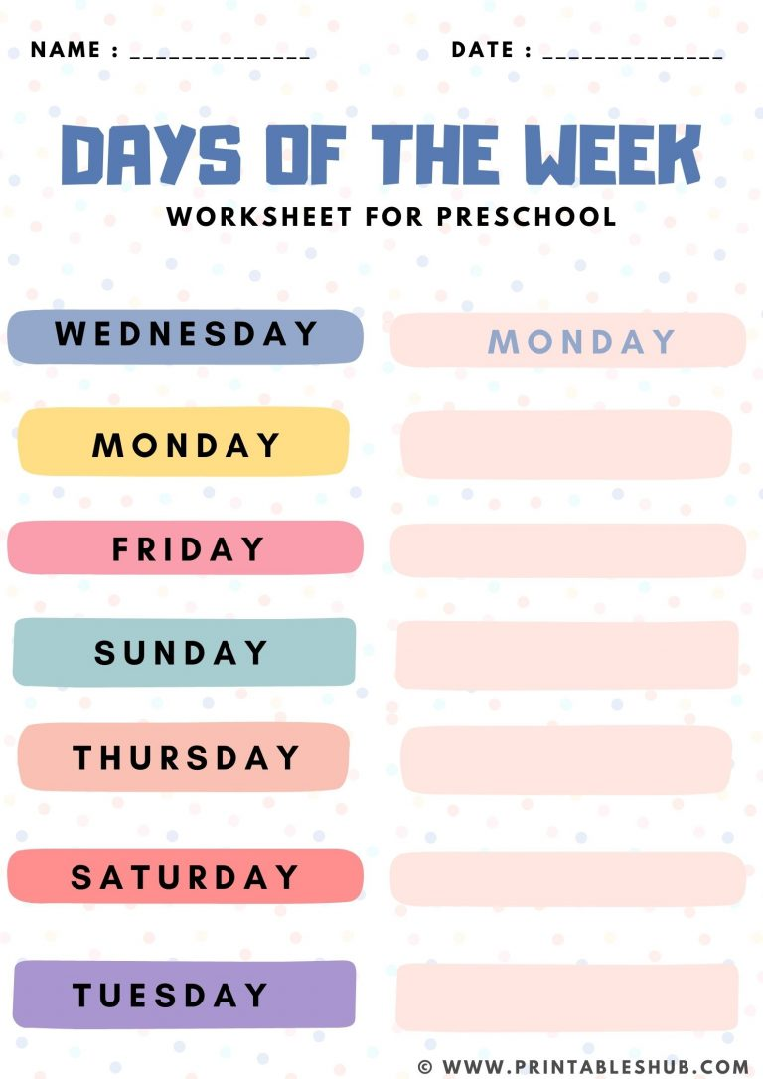
Group 3
Arrange the days of the week in order

Slide 29
Week 6
3D Shapes

Slide 30
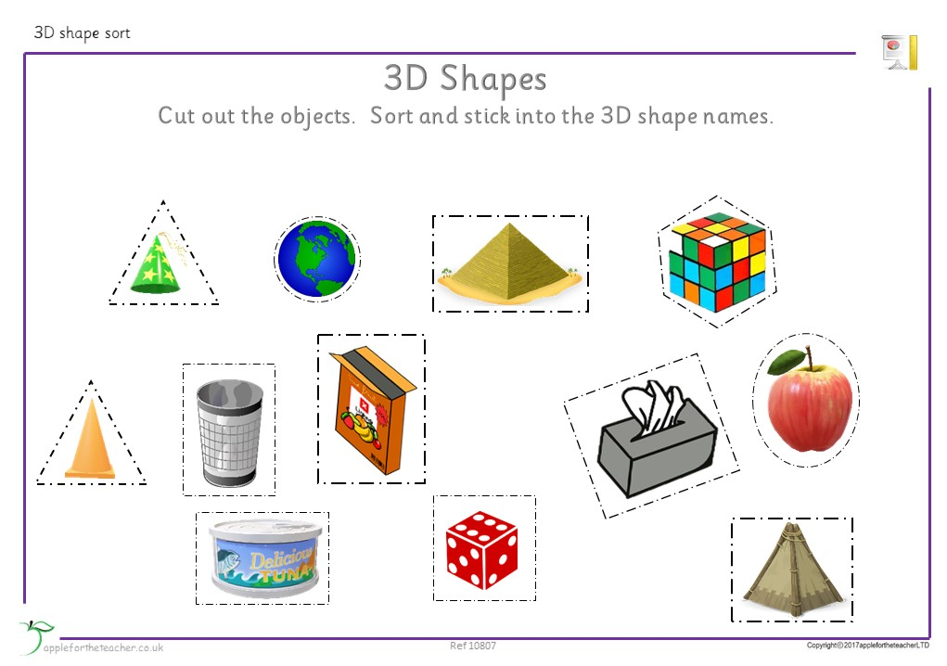
Every day 3D objects

Slide 31
Lesson objectives
Recognize 3D shapes.
Identify the 3D shapes.
Name the 3D shapes

Slide 32
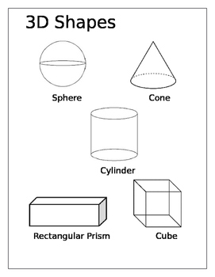
Group 1
Color the following 3D shapes

Slide 33
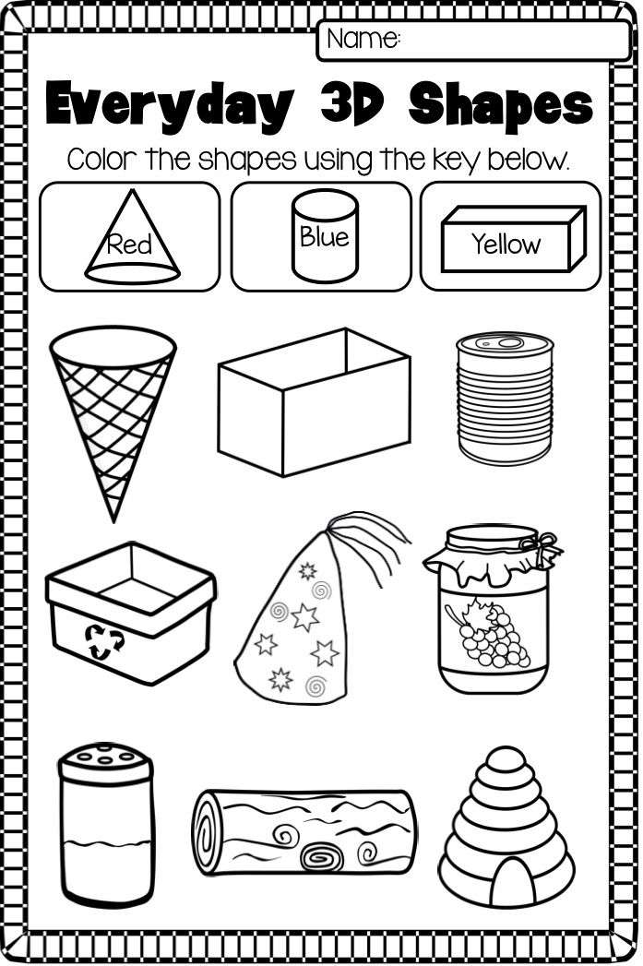
Group 2

Slide 34
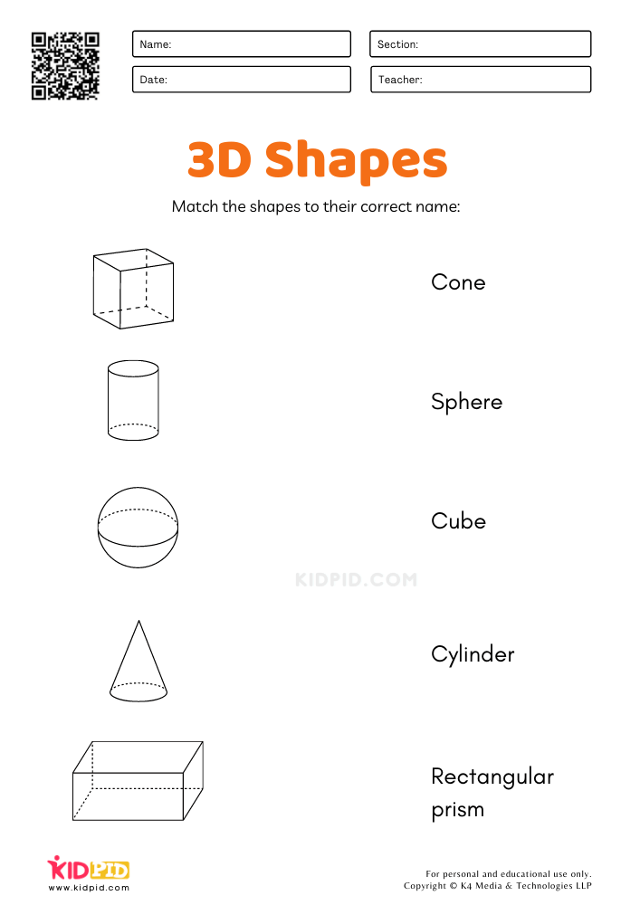
Group 3

Slide 35
Week 7
Features of shapes

Slide 36
Lesson objectives
Compare the different 3D shapes in terms of colour and size.
Draw 3D shapes like the square, triangle, rectangle, and circle.
Sort the shapes in terms of colour and size.

Slide 37
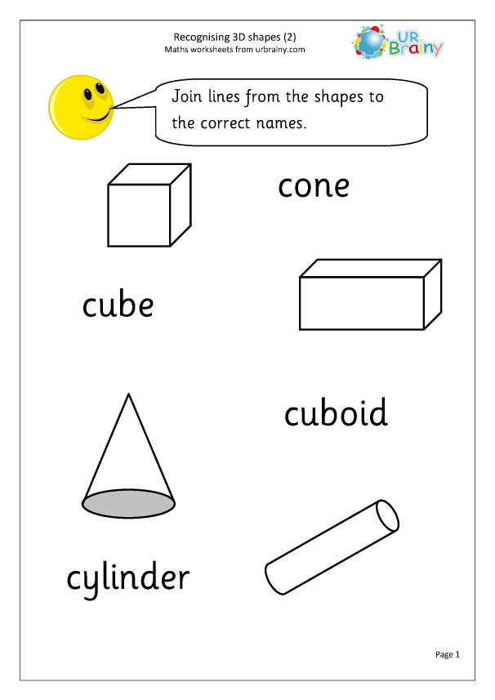
Group 1
Color the faces of the following 3D shapes Blue

Slide 38
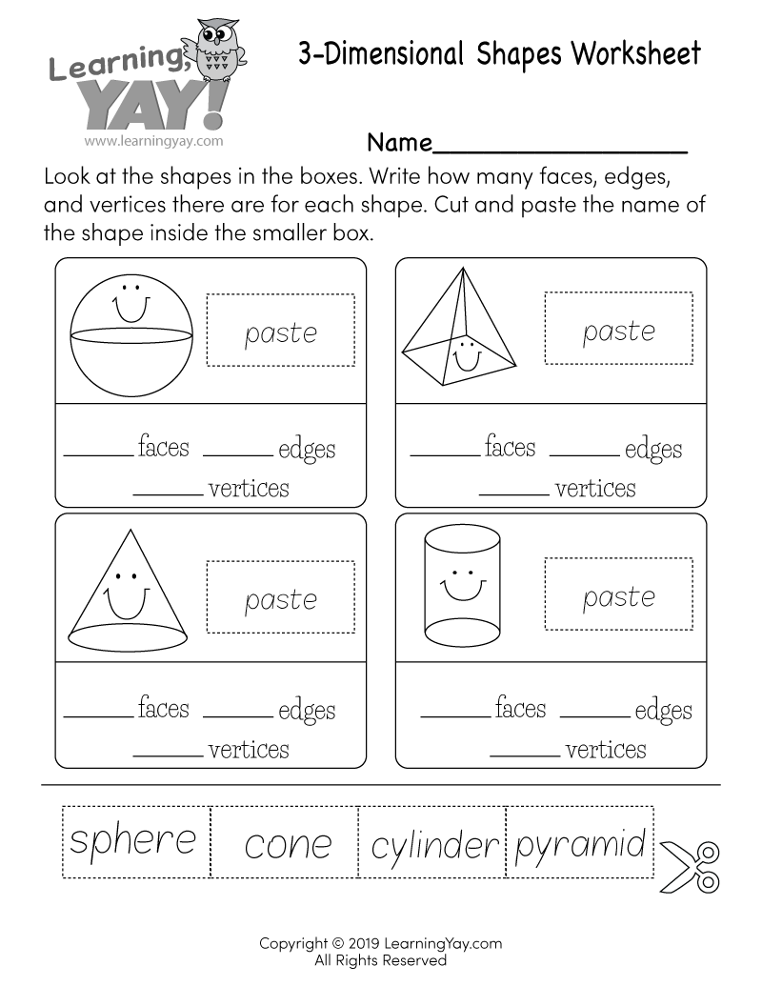
Group 2

Slide 39
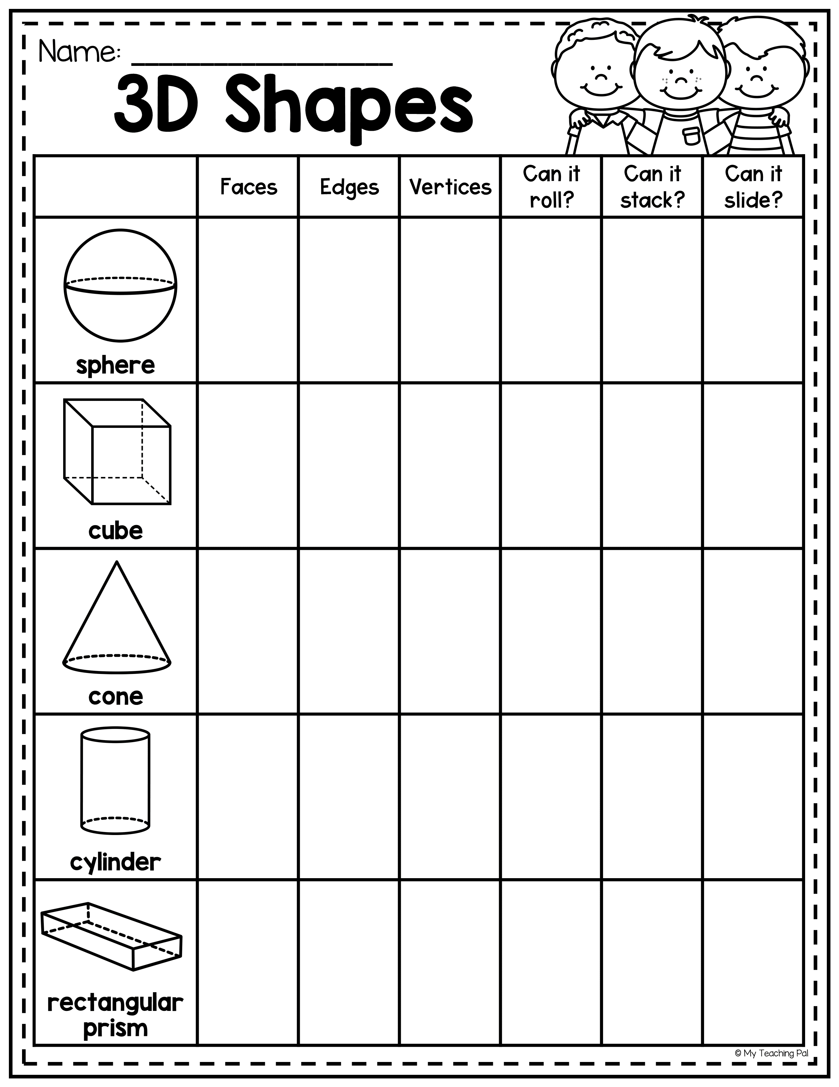
Group 3

Slide 40
Week 8
Addition and subtraction

Slide 41
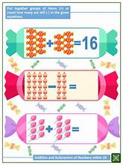

Slide 42
Lesson objectives
Identify the four operation symbols.
Add and subtract using concrete objects.
Add numbers up to 18.
Subtract numbers from 18.

Slide 43
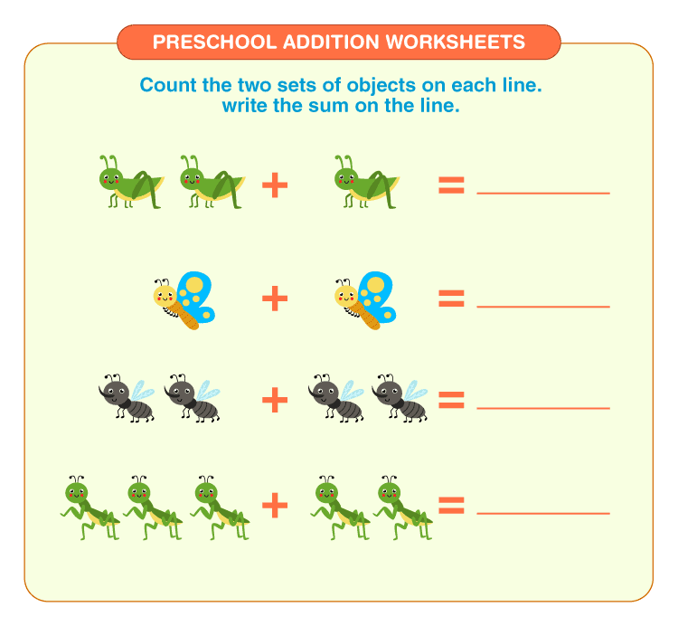
Group 1

Slide 44
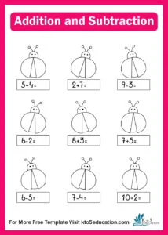
Group 2

Slide 45
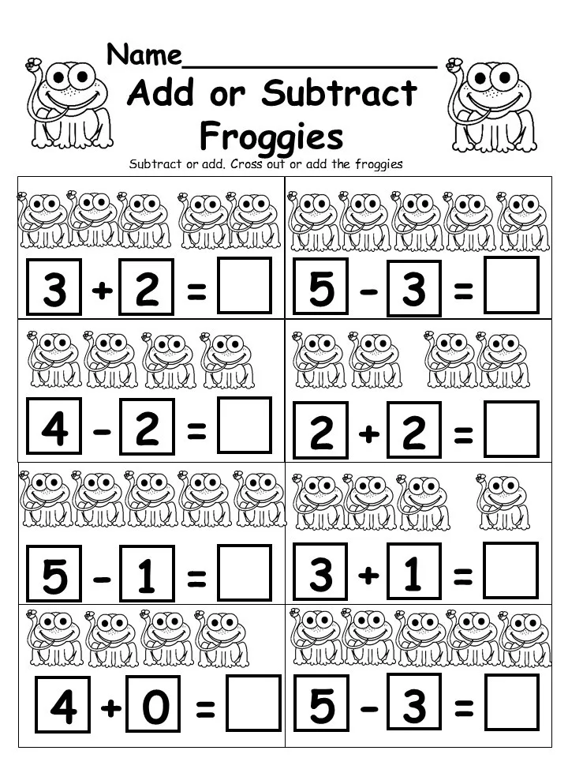
Group 3

Slide 46
Week 9
South African coins and bank notes

Slide 47
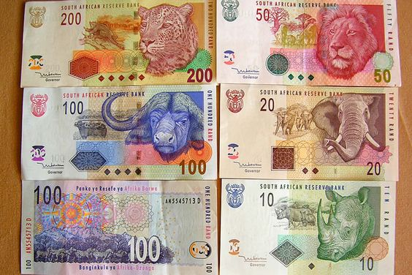
What is the picture showing? Do you recognize it?

Slide 48
Lesson objectives
Identify the South African coins and bank notes.
Recognize the South African coins and bank notes.
Add coins and bank notes.
Subtract coins and bank notes.

Slide 49
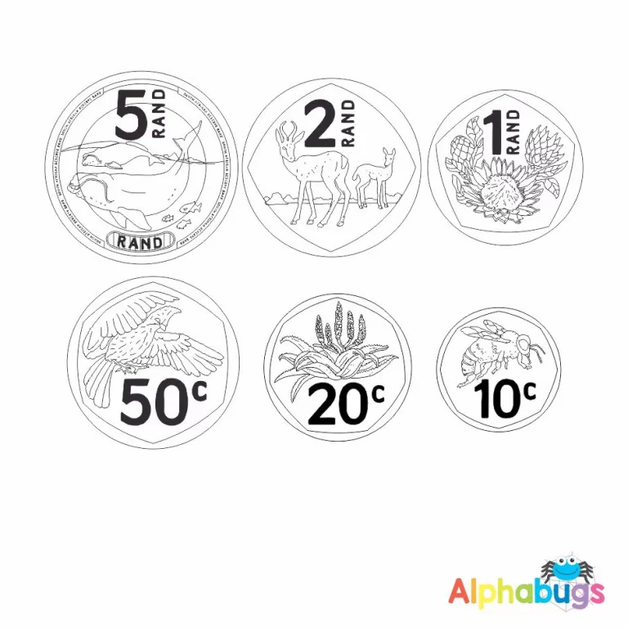
Group 1
Color the following coins

Slide 50
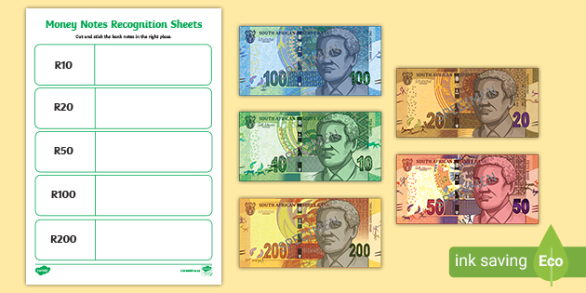
Group 2

Slide 51
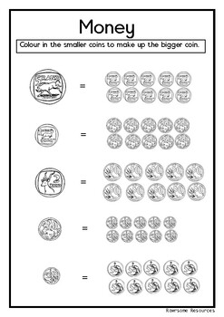
Group 3

Slide 52
Reference List

